Slide 1
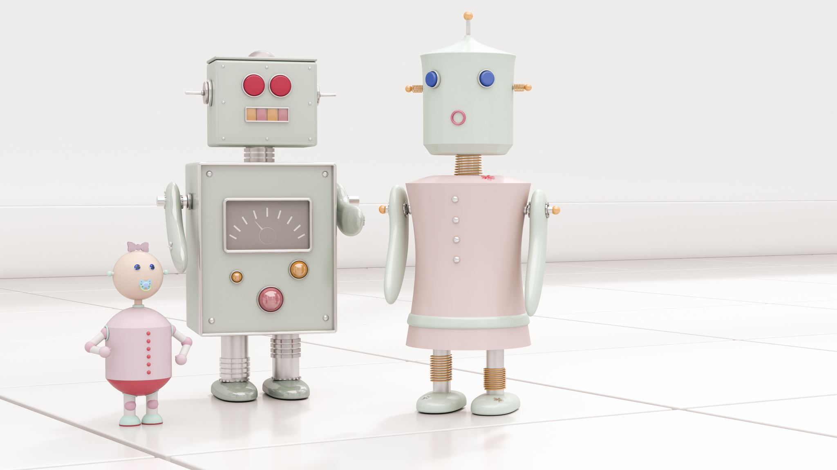
An intelligent robot for monitoring and protecting toddlers.
2023-326

Slide 2
Introduction
Modern parents have busy schedules, domestic duties, and parenting responsibilities because of that, it is difficult for them to constantly keep an eye on toddlers.
Proposed project: build an intelligent robot that remotely watches children, detects unauthorized presence, and alert parents.
Main targeted beneficials are parents of toddlers age between 3 – 5. Additionally, this product can be developed targeting for childcare centers, playgrounds and nursery schools.
Technologies used to build the proposed project: Robotics, AI, ML, Image Processing, Open CV
Functionalities:
Following the toddler and obstacle avoidance-based navigation.
Monitoring the toddler constantly while identify threats & environmental conditions.
Expelling animals that can be threatened to the toddler.
Automatically play lullabies when toddler crying.
Send alerts to the parents after capturing the child behaviors.

Slide 3
Overall Project Description
Research Problem:
Lack of sufficient supervision: Parents and caregivers may struggle to provide constant supervision for their toddlers.
Safety: Toddlers may be prone to accidents and injuries, particularly when left unsupervised.
Limitation for Communication: Parents are unable to interact with their babies directly when they are away.
Lack of flexibility to monitor while following toddler: There is no an efficient way to monitor the toddler while he is moving around.

Slide 4
Research Objectives
Main Objective:
To develop a robot capable of caring for toddlers in the absence of their parents. Overall, the research aims to create a technology that can enhance child safety and provide peace of mind for parents and caregivers.

Slide 5
Research Objectives
Sub Objectives:
Developing a navigation system for the robot that can effectively and safely navigate around the toddler, incorporating the obstacle avoidance navigation and safe movement.
To establish a virtual monitoring system for the toddler's surroundings to provide parental oversight, detect any unauthorized presence and safeguard the toddler from identifying potential threats to the child's safety.
Create a system to identify toddler behaviors and notify parents when necessary.
Create music and lullabies playing system to calm down the toddler and help him to relax.
Create graphical user interface as a mobile application for parents to easily controlling and visualize the things.

Slide 6
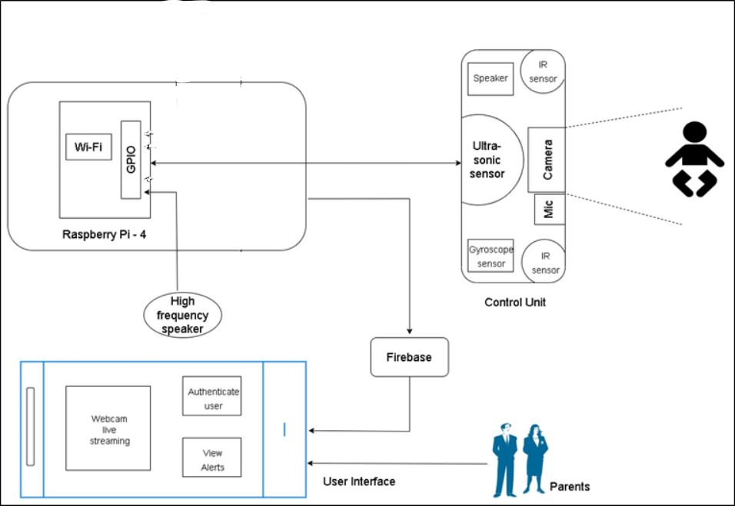
Overall System Diagram

Slide 7
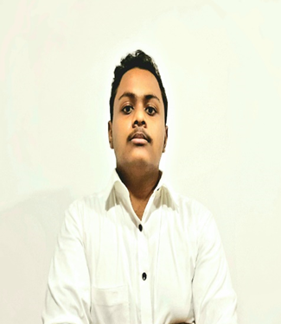
IT20185466 | R.S Thuduhena
BSc (Hons) in Information Technology
Specializing in Computer Systems & Network Engineering
IT20185466 | Thuduhena R.S | TMP-23-326

Slide 8

Research Problem
How can we design and develop a secure and robust robot navigation system that can navigate around a toddler, utilizing obstacle avoidance techniques and safe mobility, while still allowing for non-threatening human-robot interaction, even in scenarios where the child may engage with or damage the robot.
IT20185466 | Thuduhena R.S | TMP-23-326

Slide 9
Specific Objective
To develop a navigation system for the robot that can effectively and safely navigate around the toddler, incorporating the obstacle avoidance navigation and safe movement.
IT20185466 | Thuduhena R.S | TMP-23-326

Slide 10
Sub Objectives
To effectively and safely navigate around a toddler.
To accurately tracking and following the toddler.
Incorporating the obstacle avoidance navigation.
Robot must be able to clear the area intelligently, for instance if the child interacts with or destroys it.
To engage in non-threatening human-robot interaction with a toddler.
IT20185466 | Thuduhena R.S | TMP-23-326

Slide 11
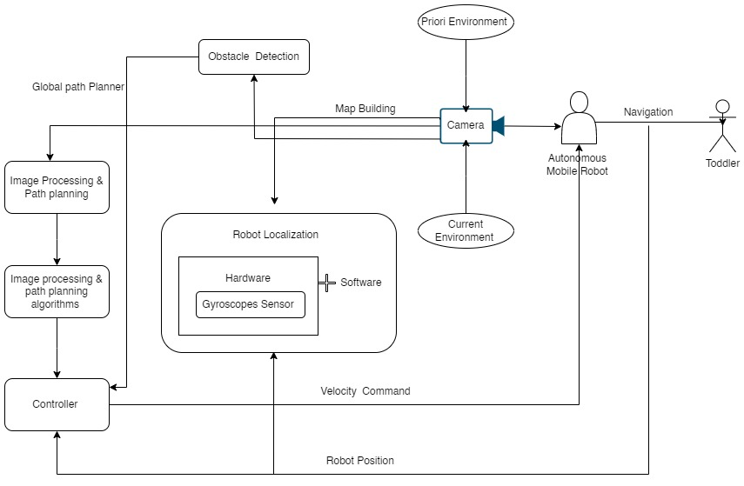
Methodology
IT20185466 | Thuduhena R.S | TMP-23-326

Slide 12
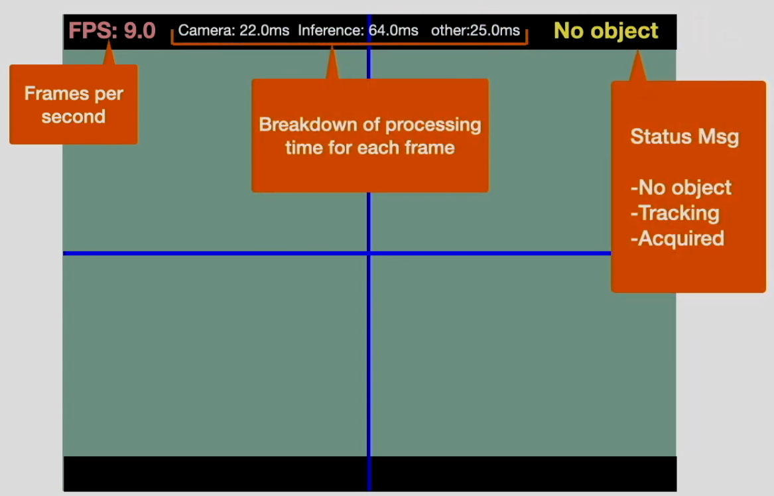
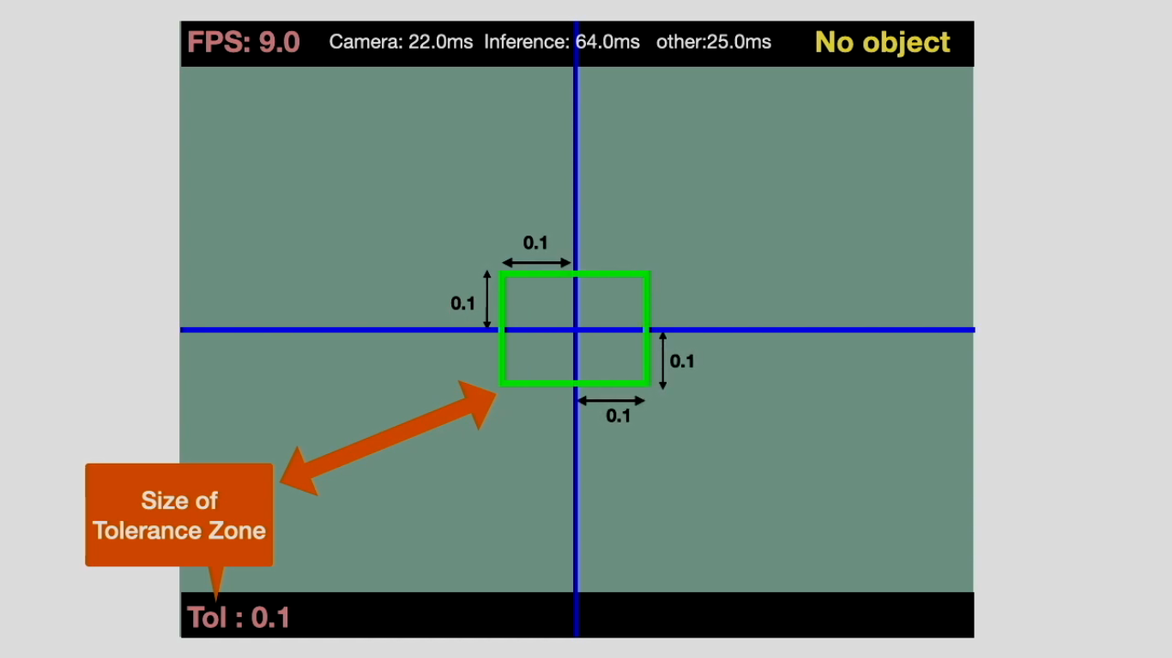
Figure - 01
Figure - 02

Slide 13
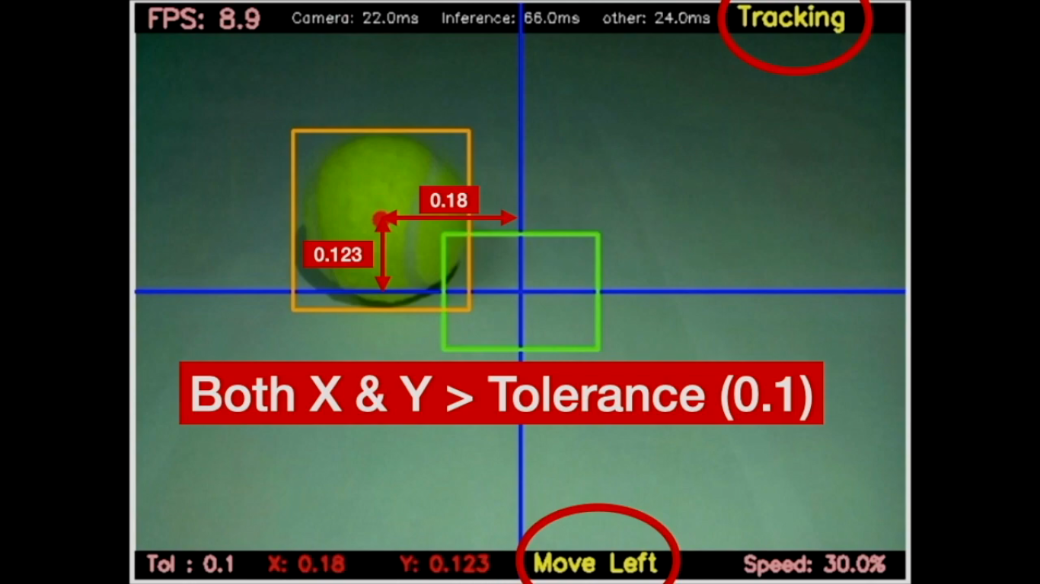
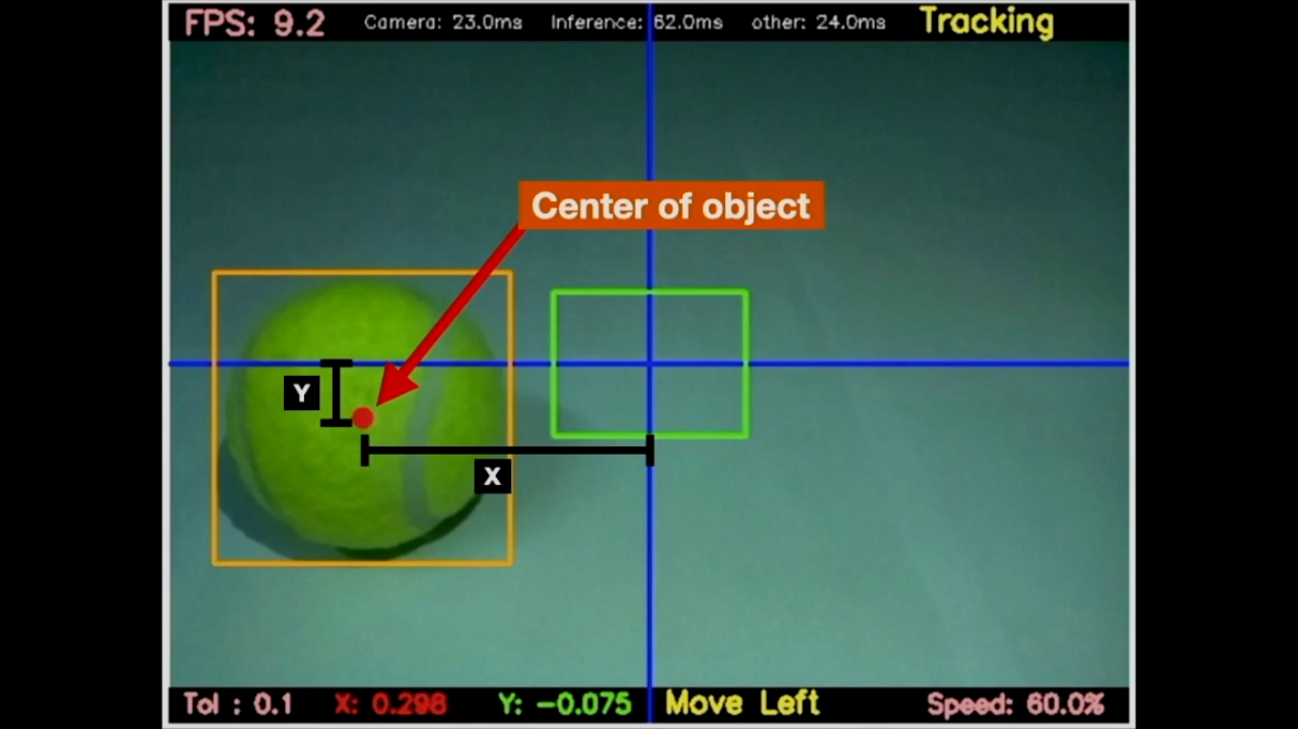
Figure - 04
Figure - 03

Slide 14
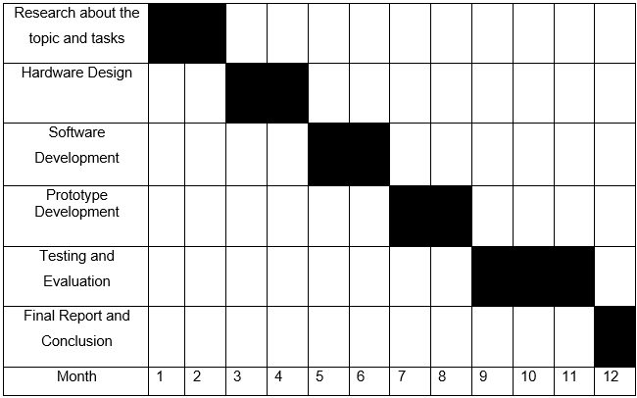
Completion of the project
IT20185466 | Thuduhena R.S | TMP-23-326

Slide 15

IT20280956 | R.M.S.S. WEERARATHNE
BSc (Hons) in Information Technology
Specializing in Computer Systems & Network Engineering
IT20280956 | R.M.S.S. WEERARATHNE | TMP-23-326

Slide 16
Research Question
The unavailability of an efficient and accurate system that provides virtual surveillance of toddlers' surroundings to detect possible threats to the kid from fire, low oxygen level, high temperature. Also, expulsion of animals that can be threatened to the toddler using humane and non-invasive approaches.
IT20280956 | R.M.S.S. WEERARATHNE | TMP-23-326

Slide 17
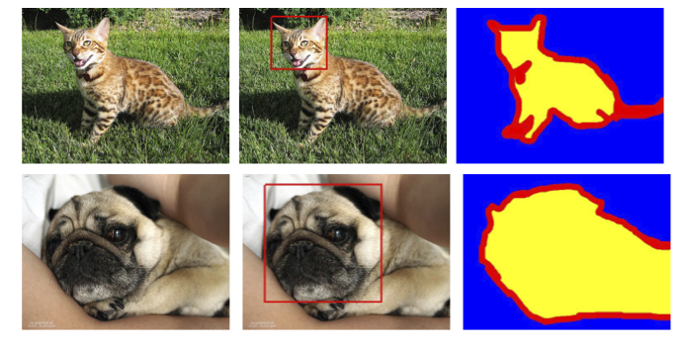
Objectives
Specific:
To design and develop a system for the robot that can offer virtual
monitoring of a toddler's surroundings while safeguard him.
Sub objectives:
To real-time detect any unpermitted presence.
To identify potential threats to the child's safety.
To expel animals that can be threatened to toddler without harm for both animal and toddler.
IT20280956 | R.M.S.S. WEERARATHNE | TMP-23-326

Slide 18
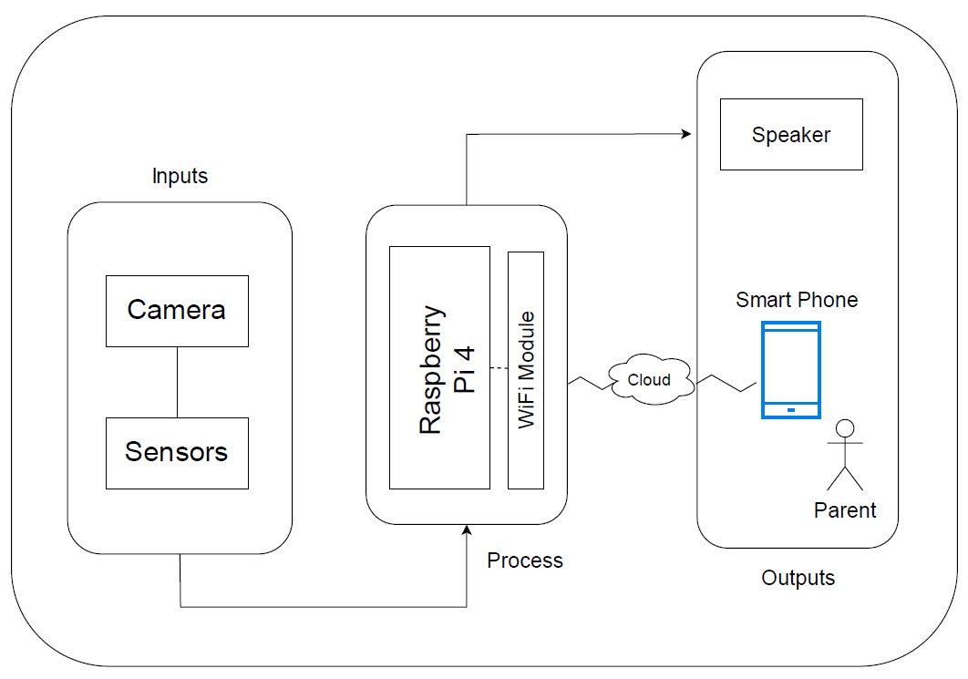
Methodology
Sensors:
IR Sensors
Technologies:
Open CV
Image processing
ML
IT20280956 | R.M.S.S. Weerarathne | TMP-23-326

Slide 19
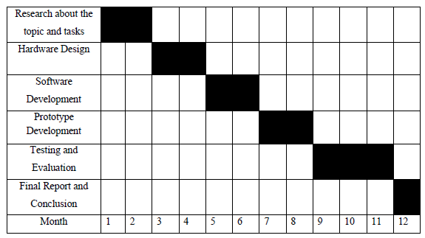
Completion of the project
IT20280956 | R.M.S.S. Weerarathne | TMP-23-326

Slide 20


IT20136260 | M.A.D.K.B. Maddepola
IT20136260 | M.A.D.K.B. Maddepola | TAF-TMP-326

Slide 21
Research Question
A parent cannot get a proper understanding of the child's behaviour and the child’s surroundings when they are away from the child.
There is no proper way to give an accurate message to parents about child's behaviour or the environment of the child.
IT20136260 | M.A.D.K.B. Maddepola | TMP-23-326

Slide 22
Objectives
Specific Objective:
Creating an alerting system that can accurately detect the behavior of the child and inform the parents about it.
Informing parents through an alert when the child is about to enter a dangerous area.
Detects the child's behavior when he kneels or falls and alerts the parents through an alerting system.
Novelty- Capturing the child's behavior and providing an accurate alert to the parents.
Sub Objectives:
Integrating with all team members in order to assemble the robot and develop the user interface.
IT20136260 | M.A.D.K.B. Maddepola | TMP-23-326

Slide 23
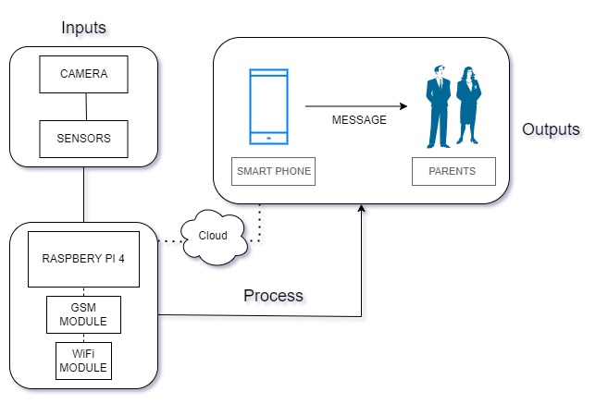
Methodology
IT20136260 | M.A.D.K.B. Maddepola | TMP-23-326

Slide 24
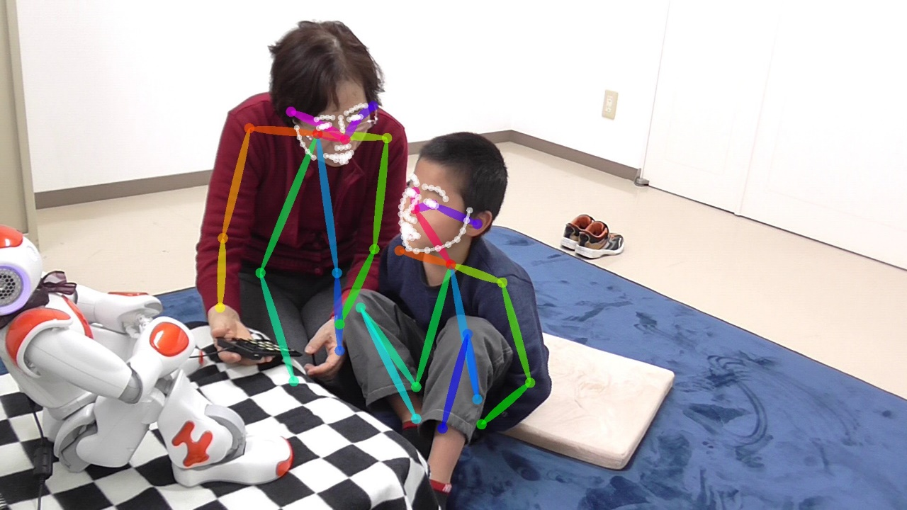
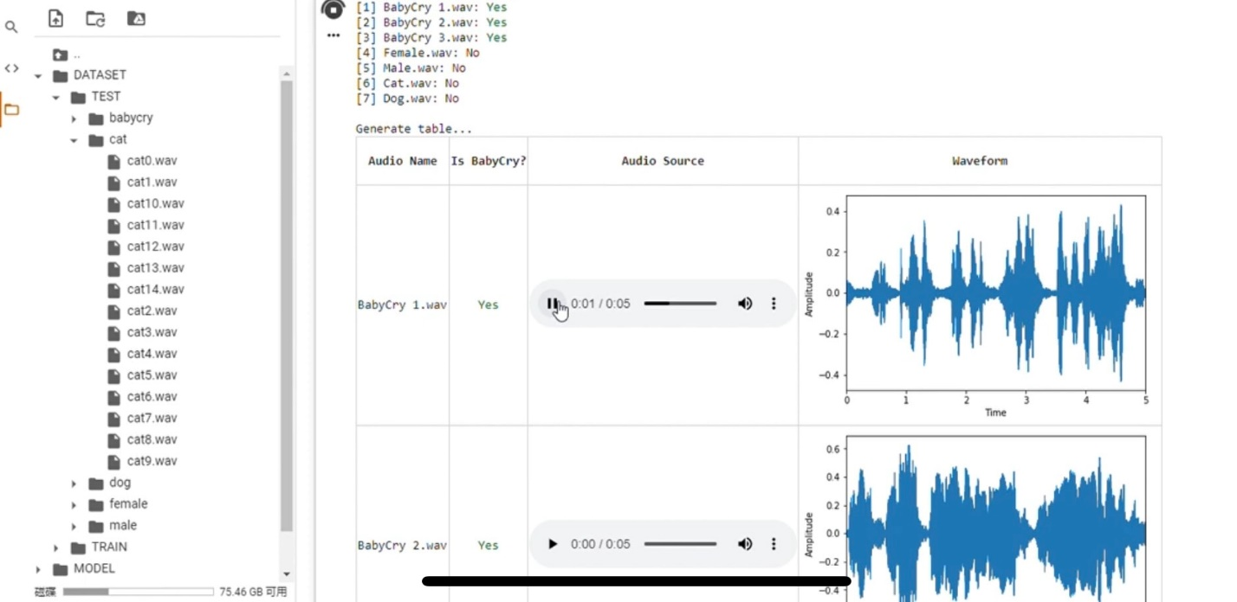



Slide 25
Completion of the project
IT20136260 | M.A.D.K.B. Maddepola | TMP-23-326

Slide 26


IT20093150| W. R. Lakshan
IT20093150 | W. R. Lakshan | TMP-23-326

Slide 27
Research Question
Currently there is no proper system for parents to look after their children
while they are away from home.
This system is designed as a remedy for the discomfort caused by the baby when it sleeps and cries.
IT20093150 | W. R. Lakshan | TMP-23-326

Slide 28
Objectives
Specific Objective:
To provide opportunities for busy parents to look after their children when they are away from home.
To avoid disturbances when the baby sleeps and cries.
Sub Objectives:
To give the opportunity to have a free mind for child as well as parents.
IT20093150 | W. R. Lakshan | TMP-23-326

Slide 29
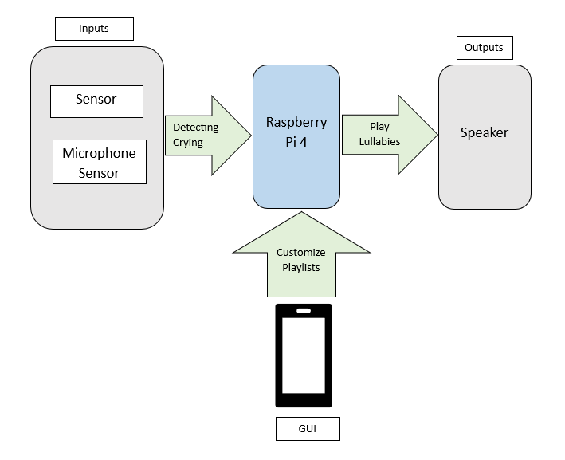
Methodology
Sensors:
Microphone Sensor
Technologies:
ML
IT20093150 | W. R. Lakshan | TMP-23-326

Slide 30
Completion of the project
Study and identify the problems regarding the topic.
Planning how to provide solution for proposed problem
Design the system diagram and proposal document
Implementing input sensor and output speaker to play lullabies.
Implementing the microphone sensors to generate the voice call.
Implementing API to communicate with the parents.
Implement the coding part and design the GUI interface
Testing the system
Present the system
Month | Jan | Feb |  | March | April | May |  | June | July | Aug | Sep | Oct
IT20093150 | W. R. Lakshan | TMP-23-326

Slide 31
Budget Allocation
Item | Price (Rs.)
Raspberry Pi 4 | 35,000
Camera | 12,000
Microphone | 8000
High frequency Speaker | 10,000
IR Sensors | 1000
Gyroscope Sensor | 500
GSM module | 500

Slide 32
References
[1] Waheb A. Jabbar, Saidatul N. I. S. Hamid, Akram A. Almohammedi, "
Internet of Things-Based Baby Monitoring System for Smart Cradle," July 2019. [Online]. Available: https://ieeexplore.ieee.org/abstract/document/8760478
[2] Miss. Amruta Gaikwad, Miss. Sweety Janrao , Prof. Shubhangi Jadhav, "AUTOMATED BABY CRADLE," INTERNATIONAL JOURNAL OF INFORMATION AND COMPUTING SCIENCE, 03 03 2019. [Online]. Available: https://ijics.com/gallery/55-mar998.pdf
[3] P. Sreevardhan, B. Vidheya Raju, and Durgesh Nandan, " Animal Repellents from Agricultural Fields," Department of Electronics and Communication Engineering, 2020. [Online]. Available: https://link.springer.com/chapter/10.1007/978-981-15-4851-2_12

